Slide 1

SE401 - Software Quality Assurance and Testing
Test Plan

Slide 2
Outlines
Test Plan vs Test Strategy
Importance of a Test Plan
Test Documentation
How to create a Test Plan
Summary

Slide 3
Test Plan and Test Strategy
Test Plan reflects test focus and project scope are defined. It deals with test coverage, scheduling, features to be tested, features not to be tested, estimation and resource management.
Test Strategy is a guideline to be followed to achieve the test objective and execution of test types mentioned in the testing plan. It deals with test objective, test environment, test approach, automation tools and strategy, contingency plan, and risk analysis

Slide 4
Test Plan
A test plan is a detailed document that outlines the test strategy, testing objectives, resources (manpower, software, hardware) required for testing, test schedule, test estimation and test deliverables.
The test plan serves as a blueprint to conduct software testing activities as a defined process which is minutely monitored and controlled by the test manager.

Slide 5
Importance of a Test Plan
Test Plan helps us determine the effort needed to validate the quality of the application under test (AUT).
Help people outside the test team such as developers, business managers, customers understand the details of testing.
Test Plan guides our thinking. It is like a rule book, which needs to be followed.
Important aspects like test estimation, test scope, Test Strategy are documented in Test Plan, so it can be reviewed by Management Team and re-used for other projects.

Slide 6
Test Plans
The most common question about testing is
“ How do I write a test plan? ”
This question usually comes up when the focus is on the document, not the contents
It’s the contents that are important, not the structure
Good testing is more important than proper documentation
However – documentation of testing can be very helpful
Most organizations have a list of topics, outlines, or templates

Slide 7
Test Plan
Objectives
To create a set of testing tasks
Assign resources to each testing task
Estimate completion time for each testing task
Document testing standards

Slide 8
Good Test Plans
Developed and Reviewed early
Clear, Complete and Specific
Specifies tangible deliverables that can be inspected
Staff knows what to expect and when to expect it
Realistic quality levels for goals
Includes time for planning
Can be monitored and updated
Includes user responsibilities
Based on past experience
Recognizes learning curves

Slide 9
Standard Test Plan
IEEE Standard 829-2008 is old but still used:
Test Plan
A document describing the scope, approach, resources, and schedule of intended testing activities. It identifies test items, the features to be tested, the testing tasks, who will do each task, and any risks requiring contingency planning
Many organizations are required to adhere to this standard
Unfortunately, this standard emphasizes documentation, not actual testing – often resulting in a well documented vacuum

Slide 10
Test Planning and Preparation
Major testing activities:
Test planning and preparation
Execution (testing)
Analysis and follow-up
Test planning:
Goal setting
Overall strategy
Test preparation:
Preparing test cases & test suite(s)
systematic
Preparing test procedure

Slide 11
Test Planning: Goal setting and strategic planning
Goal setting
Quality perspectives of the customer
Quality expectations of the customer
Mapping to internal goals and concrete (quantified) measurement
Example: customer's correctness concerns => specific reliability target
Overall strategy, including:
Specific objects to be tested
Techniques to use
Measurement data to be collected
Analysis and follow-up activities
Key: Plan the“whole thing"!

Slide 12
Types of Test Plans
Mission plan – tells “why”
Usually one mission plan per organization or group
Least detailed type of test plan
Strategic plan – tells “what” and “when”
Usually one per organization, or perhaps for each type of project
General requirements for coverage criteria to use
Tactical plan – tells “how” and “who”
One per product
More detailed
Living document, containing test requirements, tools, results and issues such as integration order

Slide 13
Test documentation

Slide 14
Test documentation
Test plan – Outline how your application will be tested in detail
Test plan
What:
a document describing the scope, approach, resources and schedule of intended testing activities; identifies test items, the features to be tested, the testing tasks, and any risks requiring contingency planning;
Who:
who will do each task;
divide responsibilities between teams involved - if more than one Software Testing team is involved (i.e., manual / automation, or English / Localization);

Slide 15
Test documentation
Test Plan (cont’d)
When:
planning/design/coding/testing stage(s);
How:
Plan for test resources / timelines;
Plan for test coverage;
Plan for OS / DB / software deployment and configuration models coverage.
After Completion:
Create and maintain the document;
Analyze for completeness;
Have it reviewed and signed by Project Team leads/managers.

Slide 16
Test documentation
Test Case
Required elements of a Test Case:
ID – unique identifier of a test case
Features to be tested
Steps – what you need to do
Input data
Expected result – what you are supposed to get from application
Actual result – what you really get from application
Pass / Fail

Slide 17
Test documentation
Test Case
Optional elements of a Test Case:
Title – verbal description indicative of test case objective
Goal / objective – primary verification point of the test case
Project / application ID / title – for TC classification / better tracking
Functional area – for better TC tracking
Bug numbers for Failed test cases – for better error / failure tracking (ISO 9000)
Positive / Negative class – for test execution planning
Manual / Automatable / Automated parameter etc. – for planning purposes
Test Environment

Slide 18
Test documentation
Test Case
Inputs
Through the UI
From interfacing systems or devices
Files
Databases
State
Environment
Test Case
Outputs
To UI
To interfacing systems or devices
Files
Databases
State
Response time

Slide 19
Test documentation
Test Case
Format – follow company standards; if no standards – choose the one that works best for you
MS Word document
MS Excel document
Memo-like paragraphs (MS Word, Notepad, Wordpad)
Classes
Positive and Negative
Functional, Non-Functional and UI
Implicit verifications and explicit verifications
Systematic testing and ad-hoc

Slide 20
Test documentation
Test Suite
A document specifying a sequence of actions for the execution of multiple test cases
Purpose: to put the test cases into an executable order, although individual test cases may have an internal set of steps or procedures
Is typically manual, if automated, typically referred to as test script (though manual procedures can also be a type of script)
Multiple Test Suites need to be organized into some sequence – this defines the order in which the test cases or scripts are to be run, what timing considerations are, who should run them etc.

Slide 21
Elements of a test plan 1
Title
Identification of software (incl. version/release #s)
Revision history of document (incl. authors, dates)
Table of Contents
Purpose of document, intended audience
Objective of testing effort
Software product overview
Relevant related document list, such as requirements, design documents, other test plans, etc.
Relevant standards or legal requirements
Traceability requirements

Slide 22
Elements of a test plan 2
Relevant naming conventions and identifier conventions
Overall software project organization and personnel/contact-info/responsibilities
Test organization and personnel/contact-info/responsibilities
Assumptions and dependencies
Project risk analysis
Testing priorities and focus
Scope and limitations of testing
Test outline - a decomposition of the test approach by test type, feature, functionality, process, system, module, etc. as applicable
Outline of data input equivalence classes, boundary value analysis, error classes

Slide 23
Elements of a test plan 3
Test environment - hardware, operating systems, other required software, data configurations, interfaces to other systems
Test environment validity analysis - differences between the test and production systems and their impact on test validity
Test environment setup and configuration issues
Software migration processes
Software CM processes
Test data setup requirements
Database setup requirements
Outline of system-logging/error-logging/other capabilities, and tools such as screen capture software, that will be used to help describe and report bugs

Slide 24
Elements of a test plan 4
Discussion of any specialized software or hardware tools that will be used by testers to help track the cause or source of bugs
Test automation - justification and overview
Test tools to be used, including versions, patches, etc.
Test script/test code maintenance processes and version control
Problem tracking and resolution - tools and processes
Project test metrics to be used
Reporting requirements and testing deliverables
Software entrance and exit criteria
Initial sanity testing period and criteria
Test suspension and restart criteria

Slide 25
Elements of a test plan 5
Personnel allocation
Personnel pre-training needs
Test site/location
Outside test organizations to be utilized and their purpose, responsibilities, deliverables, contact persons, and coordination issues
Relevant proprietary, classified, security, and licensing issues
Open issues
Appendix - glossary, acronyms, etc.

Slide 26
Test Plan Contents
Purpose
Outline
Test-plan ID
Introduction
Test reference items
Features that will be tested
Features that will not be tested
Approach to testing (criteria)
Criteria for pass / fail
Criteria for suspending testing
Criteria for restarting testing
Test deliverables
Testing tasks
Environmental needs
Responsibilities
Staffing & training needs
Schedule
Risks and contingencies
Approvals

Slide 27
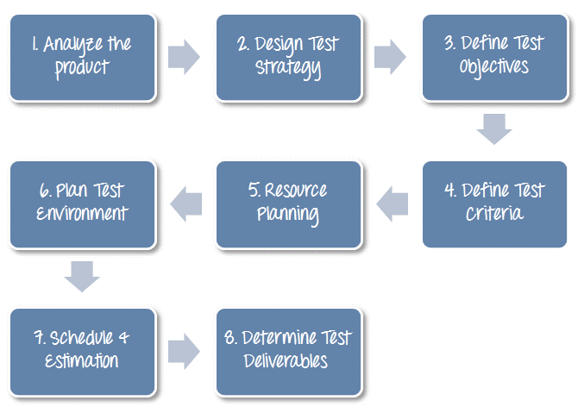
How to write a Test Plan
Creating a Test Plan is the most important task of Test Management Process. Follow the seven steps below to create a test plan as per IEEE 829

Slide 28
1. Analyze the Project
1. Review product and project documentation
2. Perform product walkthrough
3. Interview client, designer and developer
Can you test a product without any information about it?
No… You must learn a product thoroughly before testing it.
You can use the following approach to analyze the product:

Slide 29
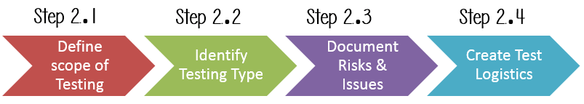
2. Develop Test Strategy
Test Strategy is a critical step in making a Test Plan. This document defines:
The project’s testing objectives and the means to achieve them
Determines testing effort and costs
To develop Test Strategy for testing a product, you should follow steps below:

Slide 30
2. Develop Test Strategy
Step 2.1) Define Scope of Testing
Before the start of any test activity, scope of the testing should be known.
The components of the system to be tested (hardware, software, middleware, etc.) are defined as "in scope"
The components of the system that will not be tested also need to be clearly defined as being "out of scope."

Slide 31
2. Develop Test Strategy
Step 2.1) Define Scope of Testing
To determine scope, you must consider:
Customer requirement
Project Budget
Product Specification
Skills & talent of your test team

Slide 32
2. Develop Test Strategy
Step 2.2) Identify Testing Type
A Testing Type is a standard test procedure that gives an expected test outcome. (many are available..)
The commonly used testing types are:
Unit Test: test the smallest piece of verifiable software in the application.
API Test: test the API’s created for the application
Integration Test: individual software modules combined and tested as group
System Test: conducted on a complete, integrated system to evaluate system’s compliance with its specified requirements
And more …

Slide 33
2. Develop Test Strategy
Step 2.3) Document Risk & Issues
Risk is future’s uncertain event with a probability of occurrence and a potential for loss. When the risk actually happens, it becomes the ‘issue’.
You should document those risks in the Test Plan.

Slide 34
2. Develop Test Strategy
Step 2.3) Document Risk & Issues (Example)
Risk | Mitigation
Team member lack the required skills for website testing. | Plan training course to skill up your members
The project schedule is too tight; it's hard to complete this project on time | Set Test Priority for each of the test activity
Test Manager has poor management skill | Plan leadership training for manager
A lack of cooperation negatively affects your employees' productivity | Encourage each team member in his task, and inspire them to greater efforts.
Wrong budget estimate and cost overruns | Establish the scope before beginning work, pay a lot of attention to project planning and constantly track and measure the progress

Slide 35
2. Develop Test Strategy
Step 2.4) Create Test Logistics
In Test Logistics, the Test Manager should answer the following questions:
Who will test?
When will the test occur?

Slide 36
3. Define Test Objective
Test Objective is the overall goal and achievement of the test execution
A sample of the Objectives for an online bank website:
“The test objectives are to verify the functionality of the website of the bank, the project should focus on testing the banking operation such as Account Management, Withdrawal, and Balance…etc. to guarantee all these operations can work normally in real business environment.”

Slide 37
4. Define Test Criteria
Test Criteria is a standard or rule on which a test procedure or test judgment can be based. There’re 2 types of test criteria as following:
Suspension Criteria: Specify the critical suspension criteria for a test. If the suspension criteria are met during testing, the active test cycle will be suspended until the criteria are resolved.
Example: “If testing team report that there are 40% of test cases failed, you should suspend testing until the development team fixes all the failed cases.”

Slide 38
4. Define Test Criteria
Test Criteria is a standard or rule on which a test procedure or test judgment can be based. There’re 2 types of test criteria as following:
Exit Criteria: It specifies the criteria that denote a successful completion of a test phase. The exit criteria are the targeted results of the test and are necessary before proceeding to the next phase of development.
Example:
“95% of all critical test cases must pass.”

Slide 39
5. Resource Planning
Resource plan is a detailed summary of all types of resources required to complete project task.
Resource could be human, equipment and materials needed to complete a project
The resource planning is important factor of the test planning because it helps in determining the number of resources (employee, equipment…) to be used for the project. Therefore, the Test Manager can make the correct schedule & estimation for the project. (check the Sample Test Plan on Moodle for an example)

Slide 40
6. Plan Test Environment
How do you plan for setting up a test environment for a product?
To finish this task, you need a strong cooperation between Test Team and Development Team
Test team should ask the development team all required details about the product to run to be able to clearly understand the product under test.
Sample of questions:
What is the maximum user connections which this product can handle at the same time?
What are hardware/software requirements to install this product?
Does the user's computer need any particular setting to browse the website?
Other questions …

Slide 41
7. Schedule & Estimation
To do the Schedule and time estimation it is better to break down the whole project into small tasks and add the estimation for each task separately. An example is provided below:
How can we estimate required effort?
Task | Members | Estimate effort
Create the test specification | Test Designer | 170 man-hour
Perform Test Execution | Tester, Test Administrator | 80 man-hour
Test Report | Tester | 10 man-hour
Test Delivery |  | 20 man-hour
Total |  | 280 man-hour

Slide 42
7. Schedule & Estimation
Then you create the schedule to complete these tasks.
To create the project schedule, the Test Manager needs several types of input as below:
Employee and project deadline: The working days, the project deadline, resource availability are the factors which affected to the schedule
Project estimation: Base on the estimation, the Test Manager knows how long it takes to complete the project. So he/she can make the appropriate project schedule
Project Risk : Understanding the risk helps Test Manager add enough extra time to the project schedule to deal with the risks

Slide 43
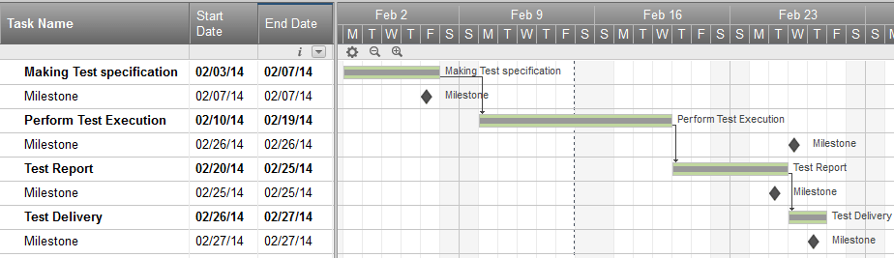
7. Schedule & Estimation
Example:
Suppose that you need to complete testing of your project in one month, you already estimated the effort for each tasks in Test Estimation. You can create a schedule similar to the one below:

Slide 44
8. Test Deliverables
Test Deliverables is a list of all the documents, tools and other components that has to be developed and maintained in support of the testing effort.
There are different test deliverables at every phase of the software development lifecycle:
Before Testing (e.g. test plans, test cases, test design specifications)
During Testing (e.g. test scripts, test data, test traceability matrix, error logs)
After Testing (e.g. test results and reports, defect report, installation guidelines, release notes)

Slide 45
Summary
Test Plan vs Test Strategy
Importance of a Test Plan
Test Documentation
How to create a Test Plan

